Slide 1
National SAT Validity Study Participation Details
April 2018

Slide 2
Agenda
Overview of the Study
Participation Resources/Getting Started
Overview of the Admitted Class Evaluation Service™ (ACES) System
Top 10 Common FAQs
Help Along the Way!

Slide 3
Overview of the Study
Your participation will help inform and strengthen the college readiness and success knowledge base.
It also comes with benefits to your institution.
A customized institution-specific admission validity study with interactive graphs summarizing institutional study results
A comprehensive matched data file with student-level variables from a College Board database
A stipend payable to your institution/office ($1,000) for the work involved in assembling and submitting the requested data file
National study to examine SAT score relationships with key college outcomes across a large and diverse sample of four-year institutions.

Slide 4
Overview of the Study (cont.)
Data collection (via ACES) between May 1 and July 31, 2018.
Can begin any time after first-year data are available.
File to include: First-time, first-year students in the entering Fall 2017 cohort.
Institutions with at least 250 students (and at least 75 SAT takers).
More than 170 institutions already signed on to participate.
Institution-specific results available in 20 business days from receipt of clean data file in ACES system.
National results available in May/June 2019.
TIMELINE

Slide 5
Overview of the Study (cont.)
The National SAT Validity Study uses the College Board’s secure, online validity study service, ACES, to receive files for the study.
ACES can help institutions to:
implement predictive models for admission, advisement, and retention
analyze new predictors
evaluate the relative and combined value of predictors
examine results by subgroups
examine results over time
Evaluate/modify credit or placement policies based on institutional data
aces.collegeboard.org

Slide 6
Overview of the Study (cont.)
5 studies available; 2 studies coming soon
Admission Validity Study
SAT Placement Validity Study
ACCUPLACER Placement Validity Study
AP Placement Validity Study
CLEP Placement Validity Study
Completion Study (launching in summer)
Retention Study (launching in summer)
Other offerings in the system for another day….
The New ACES System Launched on February 1, 2018

Slide 7
Participation Resources/Getting Started

Slide 8
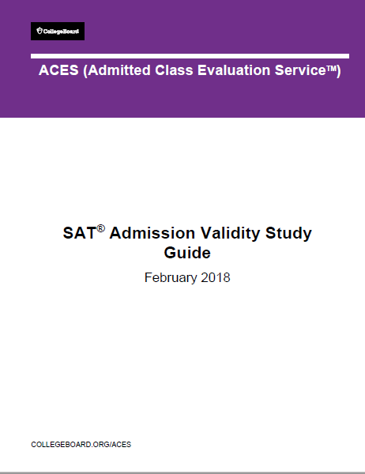
Study Participation Resources / Getting Started
SAT Admission Validity Study Guide
Step-by-step instructions with screenshots on how to use the ACES system to design and request an SAT Admission Validity Study
FAQ Section of ACES Web Site
General
Admission Validity Studies
Using the ACES Portal
Helpful tools and documents to have handy from the ACES web site
aces.collegeboard.org/resources

Slide 9
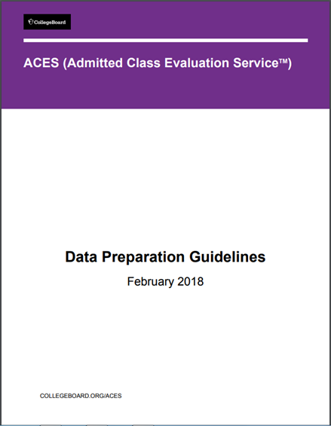
Data Template
National SAT Validity Study Data Template – 4 Year
Excel file with the correct data layout for institutions taking part in the National SAT Validity Study. You can download this file and plug in your data to create your student data file.
Prepare the data template while consulting the ACES Data Preparation Guidelines
For detailed information on preparing your data file, data definitions, formatting, etc.
Data Variable | Example
student_id* | 1234567
first_name* | Patricia
middle_name* | J.
last_name* | Smith
Sex* | F
Dob* | 8/8/1997
address_line1 | 1234 Brooke Street
address_line2
address_city | Houston
address_state | TX
address_zip* | 77006
address_country | United States
hs_ai_code* | 443376
hs_gpa | 3.85
gpa_cum* | 3.65
course_code* | INFO 101
course_section | 001
course_title* | Introduction to Information Science
course_term* | 2017-S1
course_grade* | A-
course_credits_attempted* | 4.00
course_credits_earned | 4.00
course_credits_degree | 4.00
course_source | HM (home institution)
course_completion_date | May 25, 2018
The following code list is recommended:
HM : Home Institution
DE : Dual Enrollment Transfer Course (prior to high school graduation)
IT : Other Institution Transfer Course (after high school graduation)
SA : Study Abroad Transfer Course
XI : Exam, Internal to Institution (e.g., departmental test)
XE : Exam, External to Institution (e.g., AP, CLEP, IB)
OT : Other or Not Applicable

Slide 10
Overview of the ACES System
…take a look inside

Slide 11
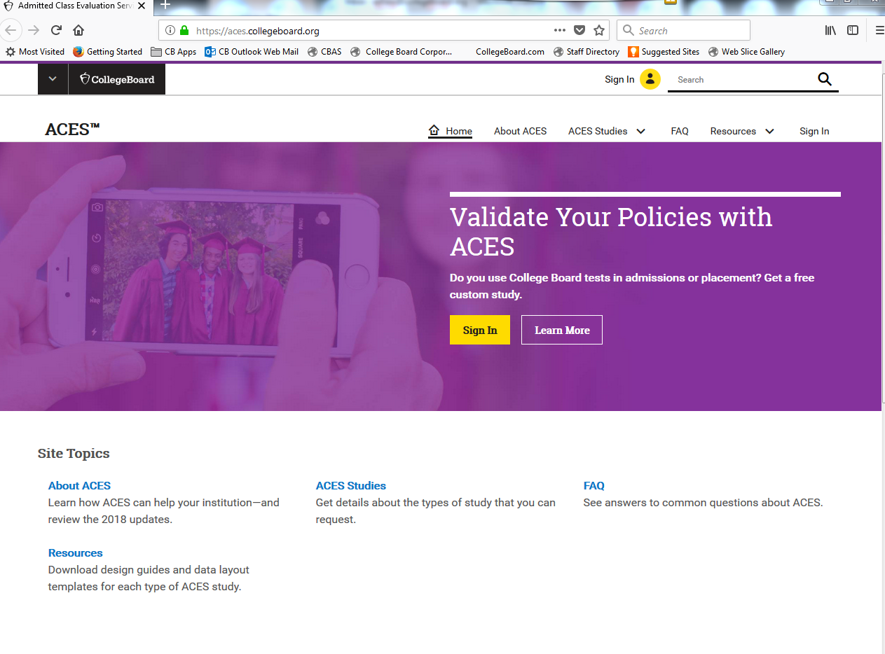
More about ACES?
aces.collegeboard.org
Note that only .edu and .gov email addresses can create accounts.

Slide 12
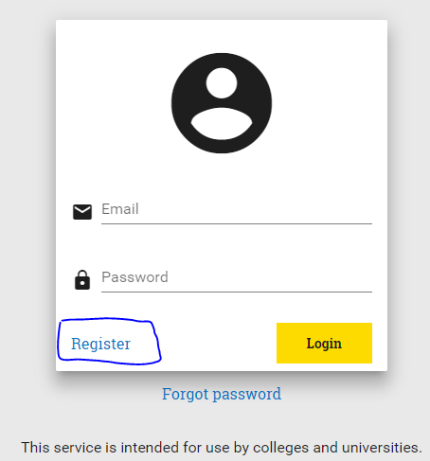
Overview of the ACES system
New user account registration
Go to https://acesportal.collegeboard.org.
Complete user profile (name, title, institution, contact information).
Email must be a .gov or .edu address.
Once account is created, check your inbox for a confirmation email to activate account.
Return to ACES to create password and log in.

Slide 13
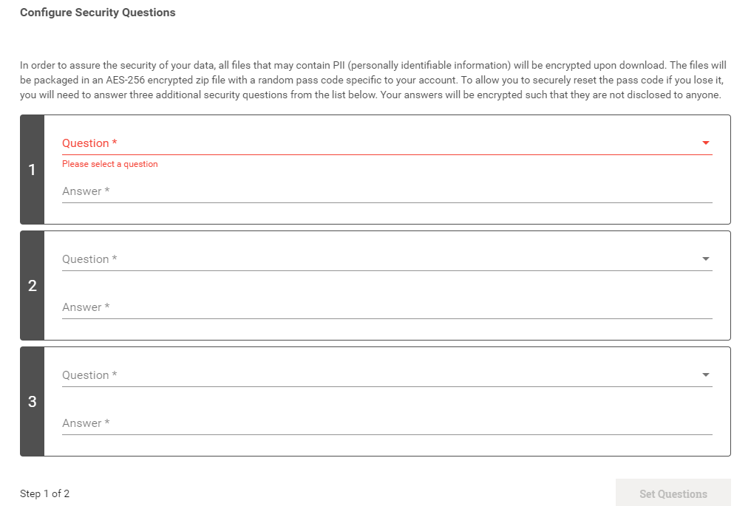
Encryption
For added encryption, you will need to set up 3 security questions to receive an encryption passcode.
This code will be required to open most files downloaded from the ACES system.
Write this down somewhere safe where you can remember location.
XTyIDwbpQzg

Slide 14
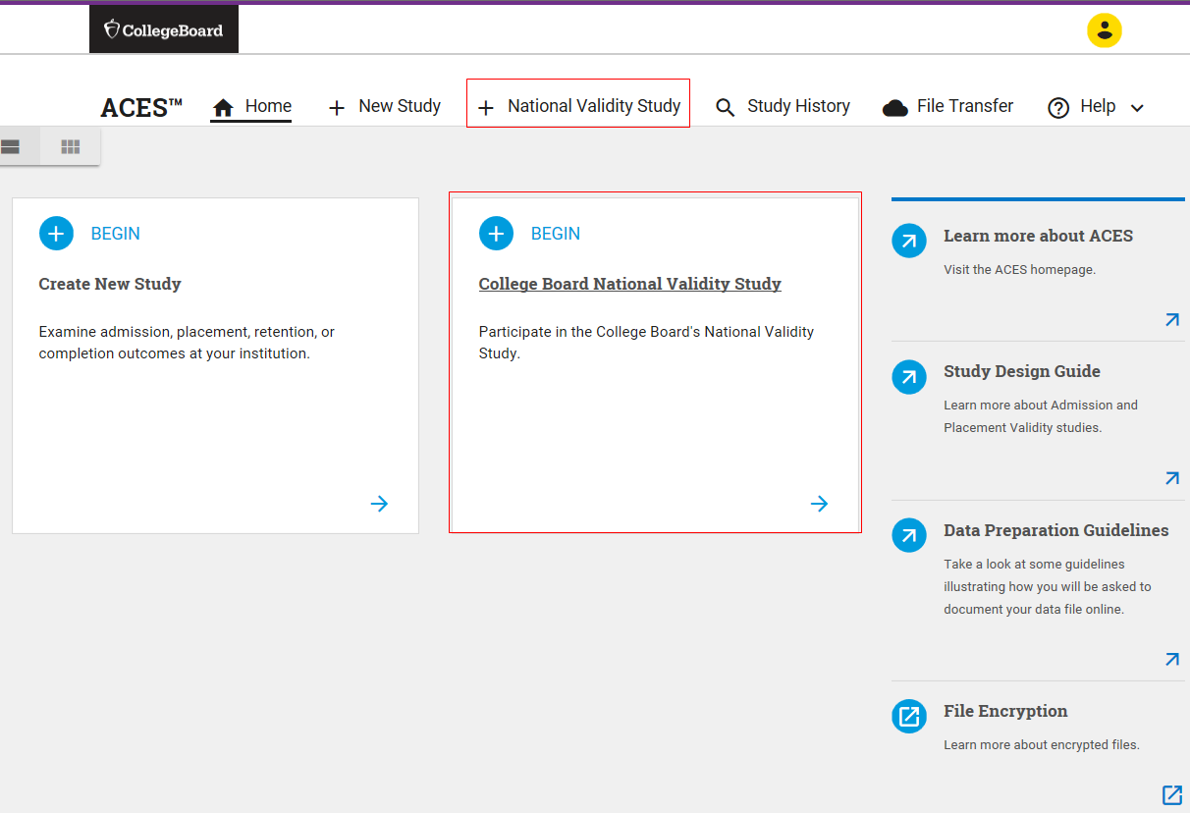
After Setting Up An Account…
From the home screen, navigate to “National Validity Study” on the menu bar or the “College Board National Validity Study” tile.
Creating a new Study request

Slide 15
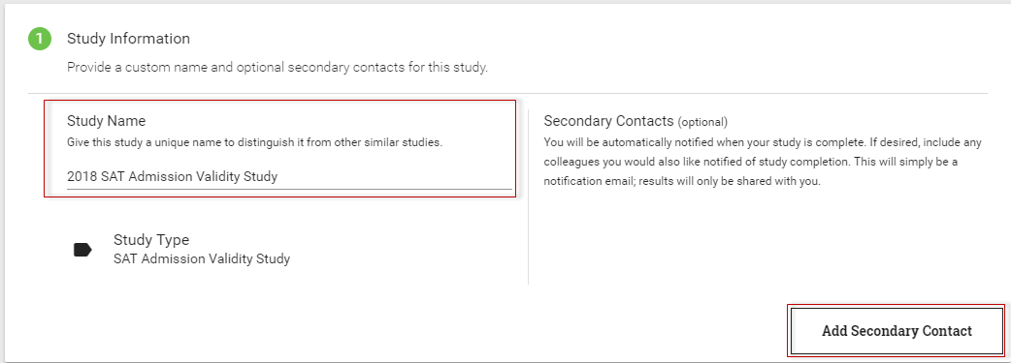
Naming your study in the system
Create a unique study name (e.g., 2018 SAT Admission Validity Study) to help identify your study
Add an optional secondary contact information to notify others when the study is complete.
This will help you identify the submission in the future.

Slide 16
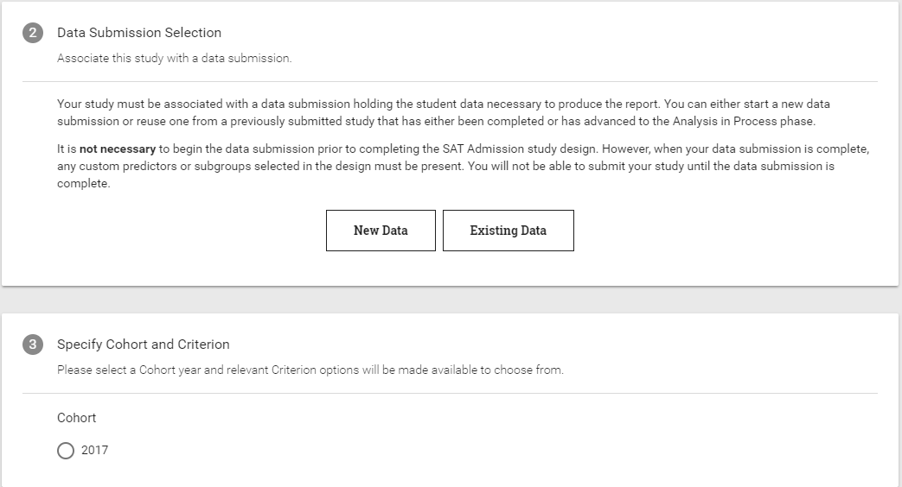
Study Design
Select a data source for the study and cohort year.
Selecting your data file

Slide 17
Supplying the HSGPA
Specify the high school GPA data source (included in your file or using ACES-supplied data--SAT questionnaire responses).
If high school GPAs are on different scales or not collected in your information system, you can use “supplied by ACES data”.

Slide 18
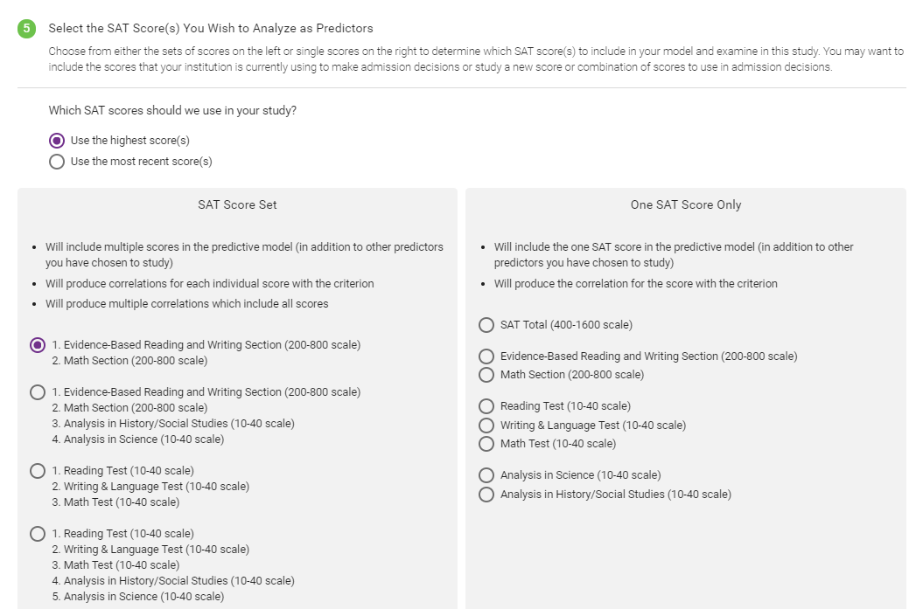
Choosing SAT Scores
Select whether to use the highest or most recent SAT score(s) to use as predictors. Choose either a score set on the left or a single score on the right.

Slide 19
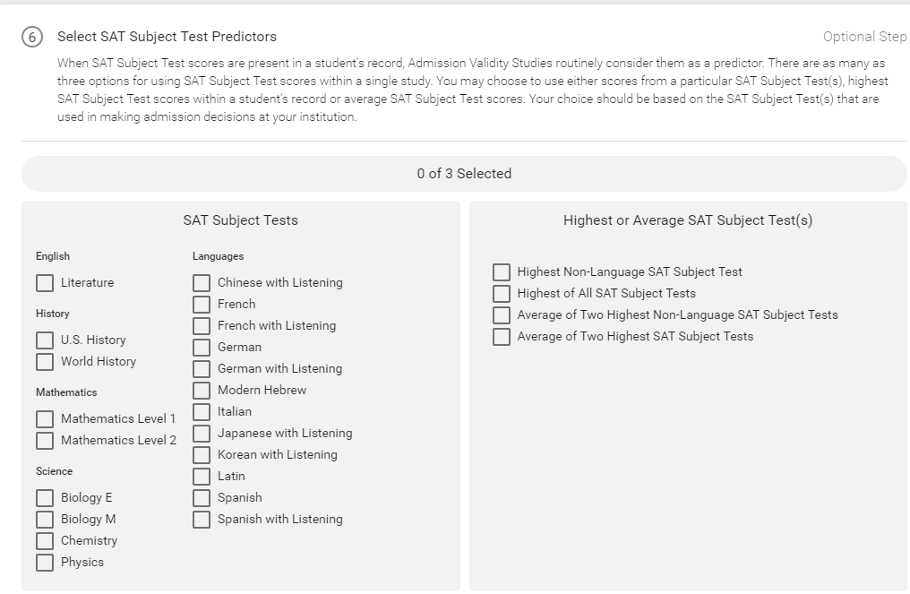
SAT Predictors- up to 3
(Optional) Select up to three SAT Subject Test predictors.

Slide 20
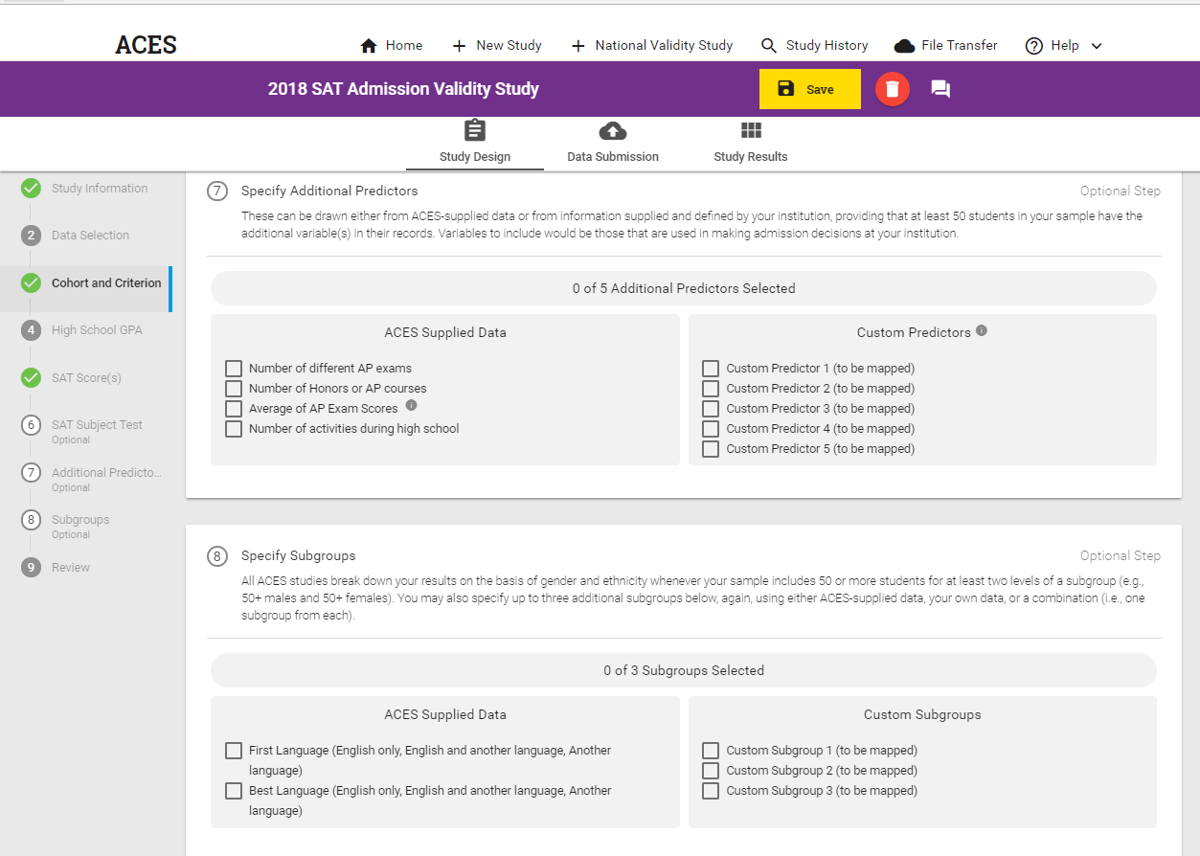
Additional Predictors, Additional Subgroups

Slide 21
Data Upload
Prepare your data file for upload:
Acceptable formats: Excel (.XLS), Comma Separated Value (CSV), SAS Transport (XPORT) or Tab Delimited (.TXT)
Refer to the Data Preparation Guide for assistance.
Recommended you use the ACES data template whenever possible, as this will help facility the data submission.

Slide 22
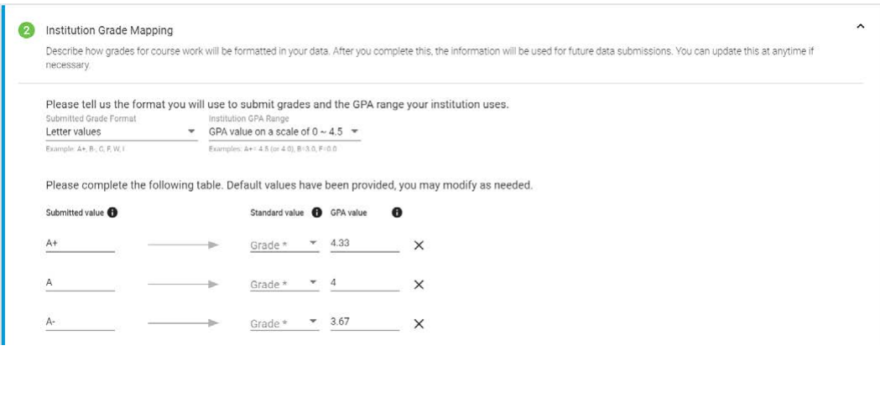
Grade Scale
Define your grading scale and add more grading standards if they apply. You will only need to indicate this information the first time you use the system as it will auto-populate in the future.
Example: Include “P/F” for Pass/Fail, W” for Withdrawn, “I” for Incomplete, AU (audit), and S (satisfactory) grades. For the numeric value, select “No value” for this scenario.

Slide 23
Academic Terms
Specify your institution’s academic terms
Description | Standardized Terms
Summer before Fall 2017-2018 (semester terms) | 2017-S0
Fall of 2017-2018 (semester terms) | 2017-S1
Spring of 2017-2018 (semester terms) | 2017-S2
Fall of 2017-2018 (semester terms) | 2017-S1
Spring of 2017-2018 (semester terms) | 2017-S2
Summer after Spring of 2017-2018 (semester terms) | 2017-S3
Fall semester of 2017-2018 (quarter Terms) | 2017-Q1
Winter semester of 2017-2018 (quarter Terms) | 2017-Q2
Spring semester of 2017-2018 (quarter Terms) | 2018-Q3
Summer semester of 2017-2018 (quarter Terms) | 2018-Q4
Fall semester of 2017-2018 (quarter Terms) | 2017-Q1
Winter semester of 2017-2018 (quarter Terms) | 2017-Q2
Spring semester of 2017-2018 (quarter Terms) | 2018-Q3
Summer I of 2017-2018 (quarter Terms) | 2018-Q4.1
Summer II of 2017-2018 (quarter Terms) | 2018-Q4.2
You will only need to indicate this information the first time you use the system as it will auto-populate in future study requests.
See pages 29-32 in the Data Preparation Guidelines document.

Slide 24
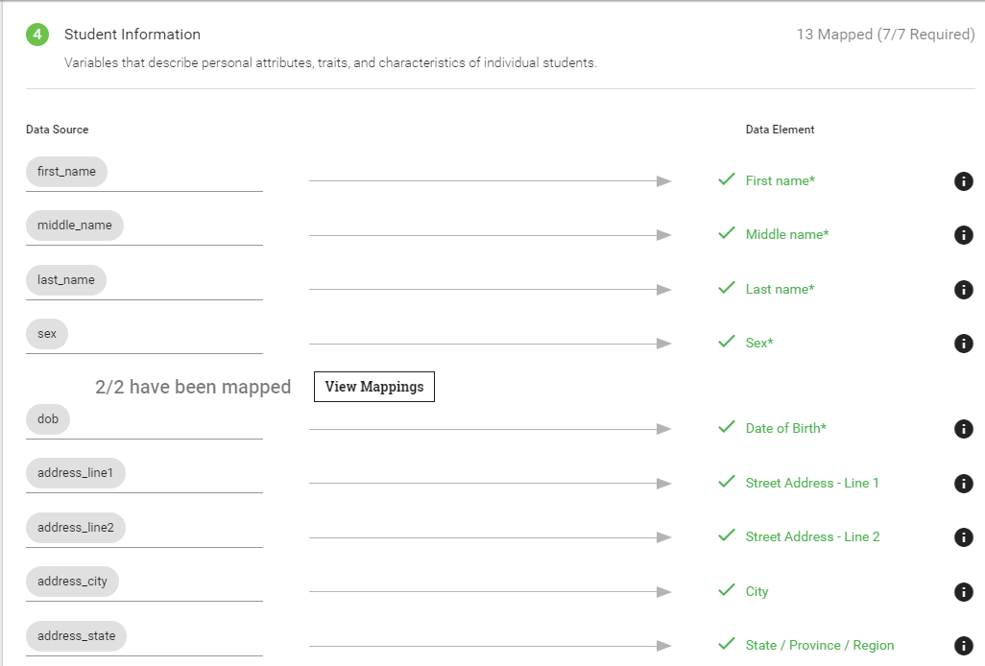
After uploading, map variables in your file to the Data Elements in the ACES System
Map file variables to the data elements.
By using the ACES data template, the mapping is done automatically.

Slide 25
Finalizing data and submission
Ensure file passes Quality Assurance (system quickly checks the file)
Required fields and values are present and complete.
Check for duplicate students or courses.
Data are formatted correctly.

Slide 26
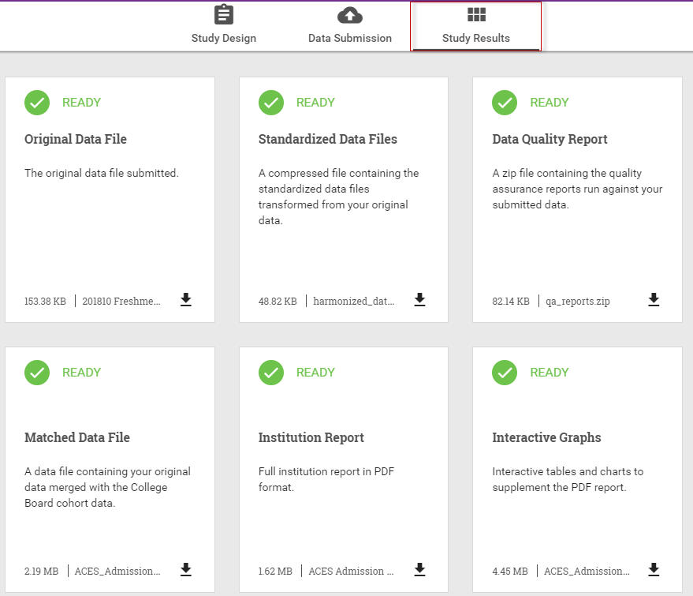
ACES Deliverables for Admission Validity Studies
Will take 20 business days from receipt of clean data to receive your completed report
Original Data File
Standardized Data File
Data Quality Report (PDF)
Matched Data File (XLS)
Institution Report (PDF)
Interactive Graphs (HTML)

Slide 27
SAT Admission Validity Study
Section 1: Descriptive summary of the admission measures
Section 2: Evaluating admission measures
Mean First-Year GPA by SAT Total Score
Mean First-Year GPA by HS GPA Quartile and SAT Total Score Quartile
Predictive strength of admission measures in your study
Predictive strength of SAT Subject Tests
Section 3: Using the admission measures for future students
Percentage of students at or above selected First-Year GPA values by SAT Total score quartiles and HS GPA quartiles
Section 4: Using predicted First-Year GPA to identify current students possibly at risk for not completing their degrees at Sample University
Plot of actual First-Year GPA by predicted First-Year GPA
Appendix A: Prediction equations for all students
Appendix B: Statistical summaries for subgroups
Analyzes the relationship between SAT scores and student performance at the institution

Slide 28
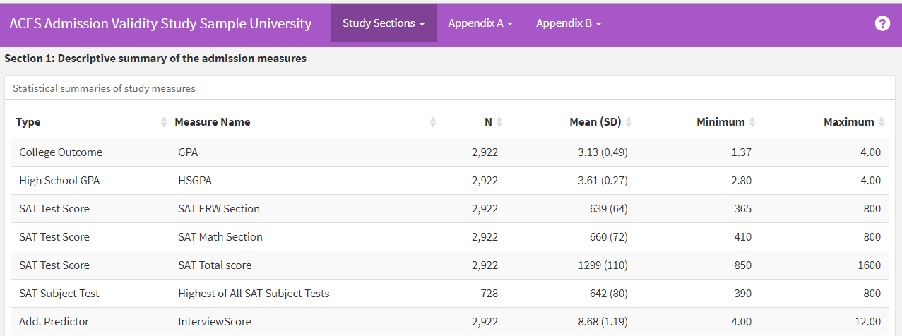
Sample Admission Validity Study Interactive Graphs

Slide 29
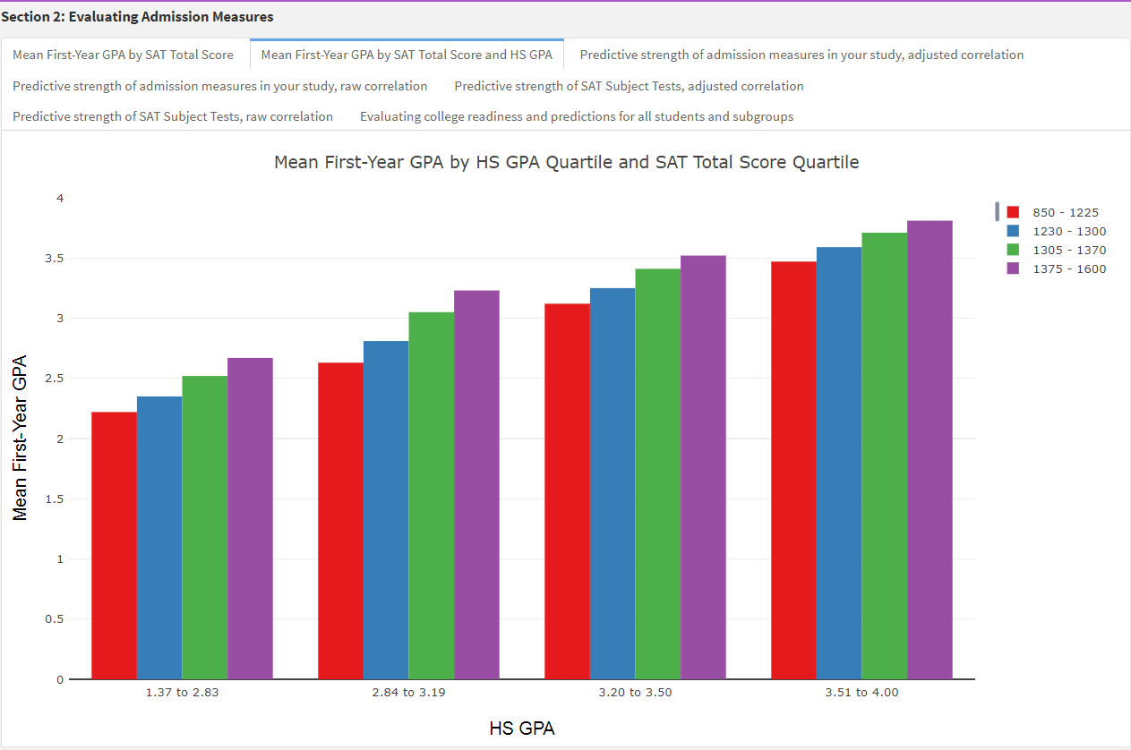
Mean FYGPA by HSGPA and SAT Total Score

Slide 30
Matched File
student_ID | PGPA (PREDICTED GRADE POINT AVERAGE calculated by ACES) | At-Risk Indicator
938293 | 3.025988195 | 2
938003 | 1.651882335 | 1
938431 | 2.131711556 | 3
975930 | 3.297089494 | 2
965939 | 2.661668091 | 2
AT-RISK INDICATOR
1 = performed higher than predicted;
2 = performed as well as predicted;
3 = performed lower than predicted and has a college GPA of 2.0 or higher;
4 = performed lower than predicted and has a college GPA lower than 2.0

Slide 31
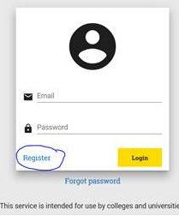
Top 10 common National SAT Validity Study FAQs
How do I register for the ACES system?
New users will need to register at acesportal.collegeboard.org.
9. We don’t capture HSGPAs in our student information system; is this a problem?
Not a problem! You can choose to use the “ACES-supplied” HSGPA taken from the student’s SAT Questionnaire data. You will indicate this choice in the ACES System.
8. How should I format my data?
In the resource section we have a data layout template ,the SAT Admissions Study Guide with step by step instructions on designing and submitting your file, and the ACES Data Preparation Guidelines.
Common questions and
answers for you

Slide 32
Top 10 common National SAT Validity Study FAQs (Cont’d)
7. Can we include student coursework with Fail, Incomplete, or Withdraw grades?
We find at most institutions if a student received a “W” for Withdrawn, “I” for Incomplete, AU (audit), S (satisfactory), and P/F (pass/fail), these grades are not calculated into the GPA, however, these grades should remain in your file. During the data submission process, you will have the opportunity to identify the numeric value for all grades included in the file, select “No value” for the grades in this scenario if this is true for your school.
6. How many predictors can I include in my admission validity study?
A study can have up to five additional predictors. An example of a predictor provided by an institution may be an academic rigor index or number of years of Math coursework. These are totally optional.
How can I include special subgroup analyses in my admission validity study?
Your results are broken down on the basis of gender and race/ethnicity whenever your sample includes 50 or more students for at least two levels of a subgroup (e.g., 50+ males and 50+ females). You may also specify up to three additional subgroups (e.g., College, Arts & Sciences, Agriculture, Architecture, etc.) or First Generation College Student (yes/no), resident versus commuter student, Pell Eligible (yes/no or 1=Yes, 2=No). These are totally optional.

Slide 33
Top 10 common National SAT Validity Study FAQs (Cont’d)
Can we see a sample Admission Validity Study report?
Yes. You can download a sample report on the ACES Admission Validity Study web page.
Is a written agreement required to participate in ACES?
Prior to submitting your ACES data file for the first time, you will be presented with the ACES data sharing agreement (.pdf/18.2KB) and you will be given the opportunity to either to “agree” or “disagree” to the terms and conditions of the agreement. If you agree, then you will be able to proceed with the data submission process in ACES. If you do not agree to sign off, then you can contact Helen Ng at hng@collegeboard.org to either develop a different written agreement for your institution with the College Board or stop the submission process. Ultimately, a written agreement must be on file with an institution prior to submitting an institution’s data file.
Can we include students who are missing SAT scores in our study?
Please include in your file ALL first-time, first-year students that began at your institution in fall 2017 and their coursework and grades from the 2017-2018 academic year.
Do we need to provide SSNs to participate in the study?
NO! Institutions do not need to submit SSNs to participate in the study.

Slide 34
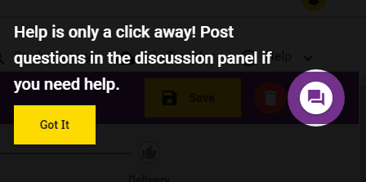
We are here for you!
Help is available using the Discussion feature at the top right corner of the screen.
Contact us by email at aces-collegeboard@norc.org or phone 1-800-439-8309 if you need technical assistance.
Feel free to reach out to Helen Ng at hng@collegeboard.org with study participation questions.
National SAT Validity Study Office Hours –coming soon!
Making Use of your ACES Results Webinar –coming soon!

